Slide 1



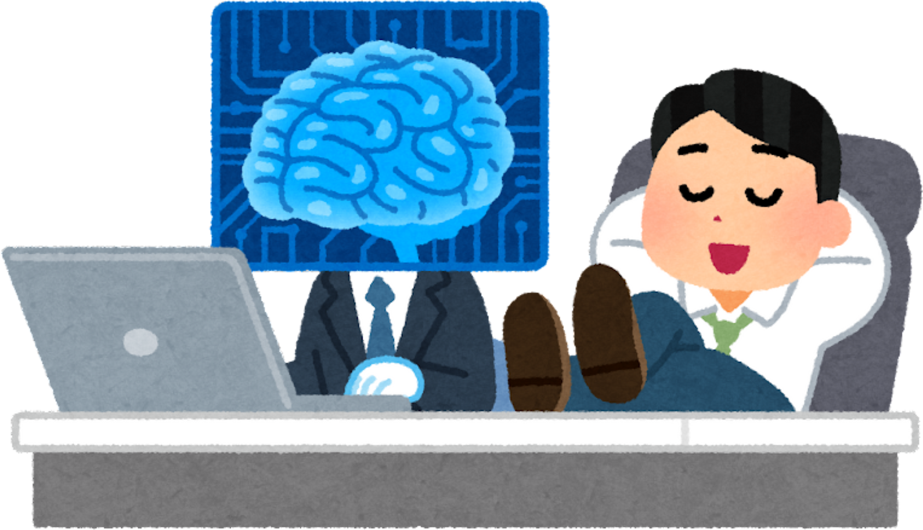
AUTORESOLVE MULTI MODAL SERVICE DESK
Reewos Talla
Evelyn Quebedo
M. Cristina Montoya
Stalin Maza
Proposal & Results -Team 7.2
Hackathon Innovation Challenge

Slide 2

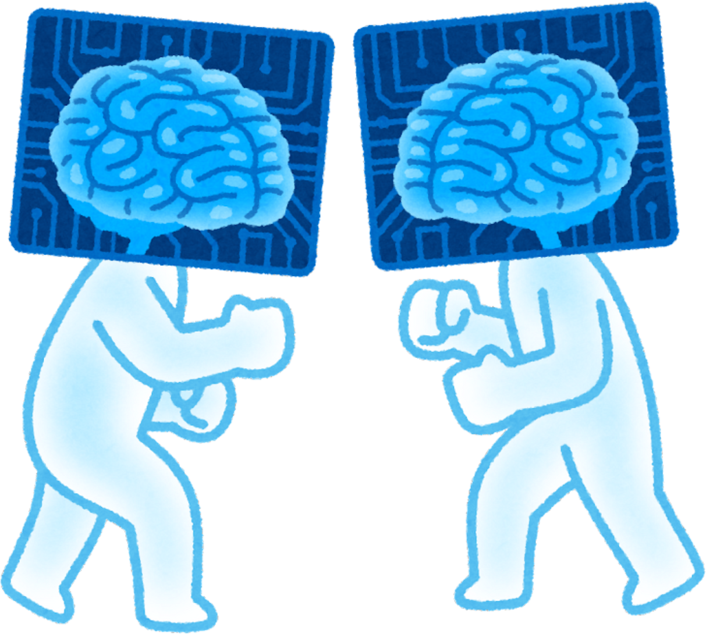
What challenges was HR facing?
Key points:
Disconnected and manual processes
High volume of repetitive employee questions
Long response times
Lack of standardized, 24/7 accessible information
Impact:
✔️ Operational inefficiency
✔️ Onboarding delays
✔️ Excessive administrative workload
✔️ Poor employee experience

Slide 3

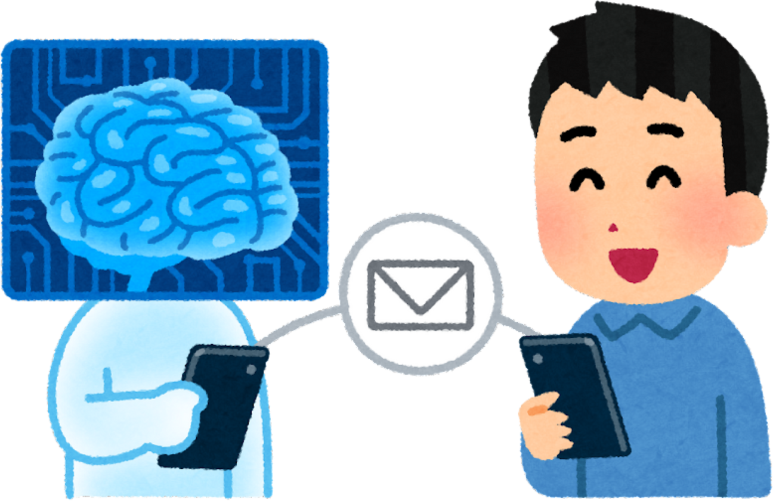
A multi modal chatbot to transform the HR experience
General objective:
Build an intelligent multimodal HR conversational chat integrated into Microsoft Teams as a corporate user, supporting voice, text, image, and interactive experiences, enabling employees to access onboarding, benefits, policies, and competency guidance through natural, contextual, and enterprise-wide channels.
Specific objectives:
Provide instant, accurate answers to FAQs
Improve accessibility to official HR policies
Reduce response time
Facilitate onboarding, PTO management, and admin tasks

Slide 4

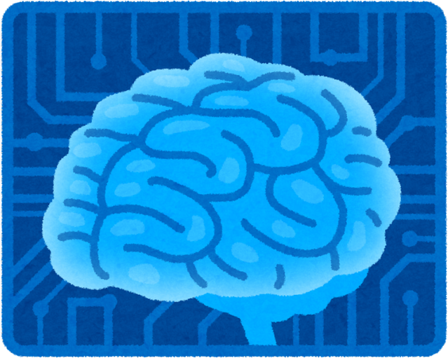
What does the chatbot cover?
Functional Blocks:
Hiring & Onboarding:
Onboarding steps, checklists, required documents
Compensation & Benefits:
Benefits, eligibility, payments, bonuses
HR Competency Model:
Expected competencies by role / level workflows, limits
Employee Handbook:
Mission, vision, code of conduct, culture
Remote Work Policy:
Rules, schedules, approved tools
PTO & Vacation Policy:
Days off, holidays, approval

Slide 5

Who benefits from this solution?
New hires
Current employees
Leaders & managers
HR team (reduced admin workload)
Value added:
✔️ Unified information
✔️ Instant access
✔️ Consistent answers
✔️ Employee self-service

Slide 6
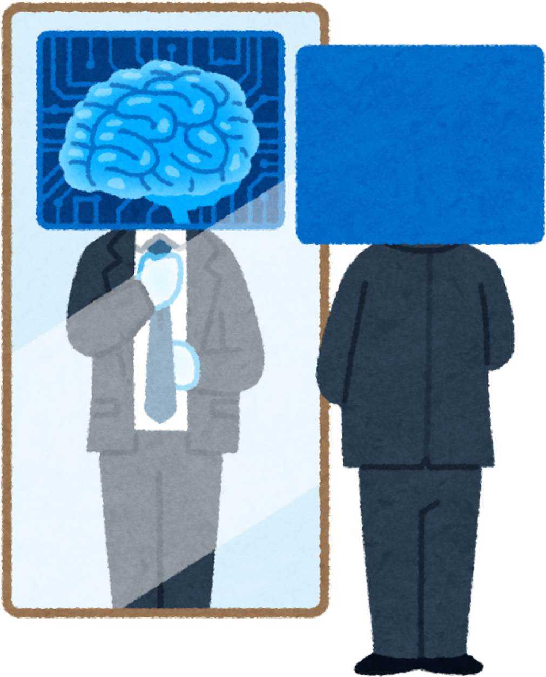

How does it work?
Components:
AI conversational engine
Structured HR knowledge base
Integration with document repositories
Decision flows for each policy area
Access controls by user type
+ Multimodal Employee Interaction (voice, text, and visual experiences)
+ Intelligent Document & Image Processing
+ Enhanced HR Navigation with Voice and Visual Assistive Capabilities

Slide 7
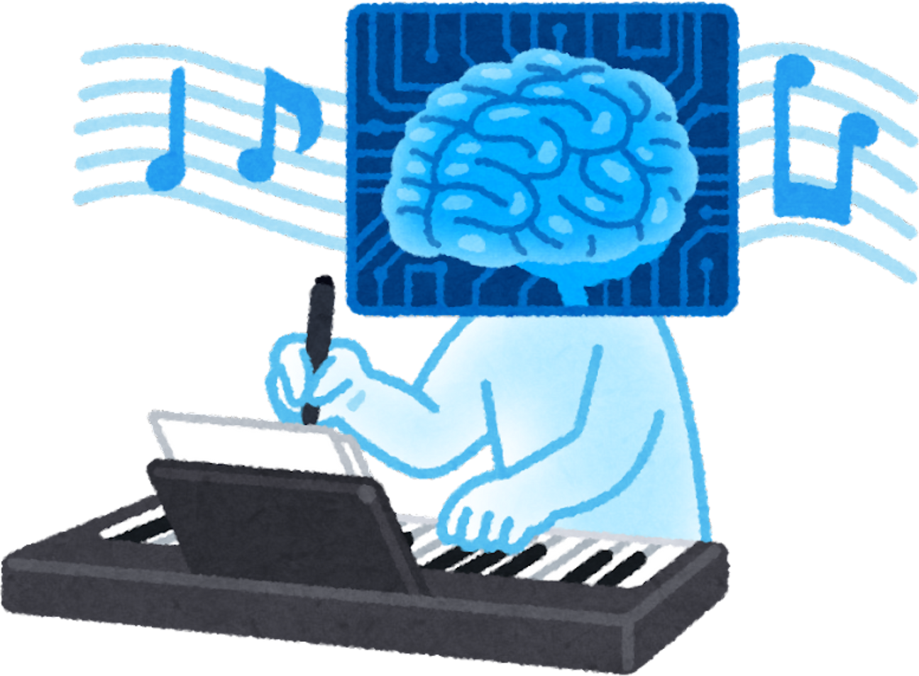

Impact achieved during the hackathon
85%+ accuracy in internal testing
Integration of 6 core HR policy areas
Verified and complete knowledge base
Smooth, intuitive conversation flows
Functional prototype ready to demo
Immediate benefits:
~40% estimated reduction in repetitive inquiries
Improved onboarding experience through automated guidance
24/7 access to critical HR information

Slide 8

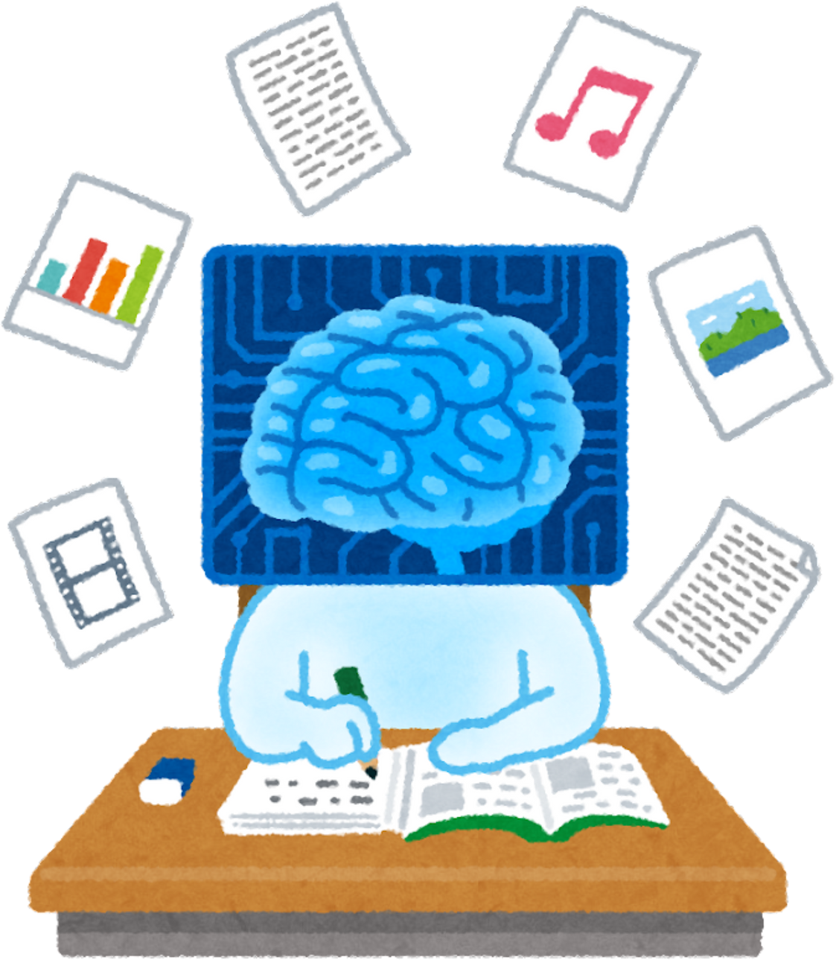
Identified Limitations
Dependent on quality/updates of official documents
Requires continuous content maintenance (because policies change inside companies)
Future integrations needed (e.g. model uploads)
Additional linguistic tuning and training

Slide 9
Strategic Roadmap
Mid Term (2-4 weeks)
Expand functional coverage and enable workflows (approvals, requests, competency insights).
Deploy the core HR chatbot including video experience
Long Term (2-4 months)
Integrate Human Resource Information systems and implement interactive visualizations for key HR processes.
Introduce predictive and personalized HR recommendations across talent, learning, and policies.
Short Term (1-2 weeks)
Deploy the core HR chatbot with including voice processing.

Slide 10
A chatbot that elevates HR
This chatbot is a strategic tool that increases efficiency, enhances employee experience, and frees HR teams to focus on higher-value work.
“Let’s take this prototype to the next level.”

